Slide 1

DCAD Practical Data Application William Welles Assistant Manager | Quality Control 214.819.2392 wellesw@dcad.org

Slide 2
About Me
Environmental Science
Spatial Analysis
Data Analysis
Chemistry
Education
Stephen F. Austin State University
MS Environmental Science
University of Illinois Chicago
BS Chemistry
Career
Dallas CAD (12 yrs)
GIS Department:
Specialist
Nacogdoches CAD (3 yrs)
Deed / Map Clerk
Dallas College (CE’s 2018)
SQL
C#
HTML
Data Analyst
QC Division:
QC Assistant Manager
Developer

Slide 3

Property Valuation the accidental profession

Slide 4
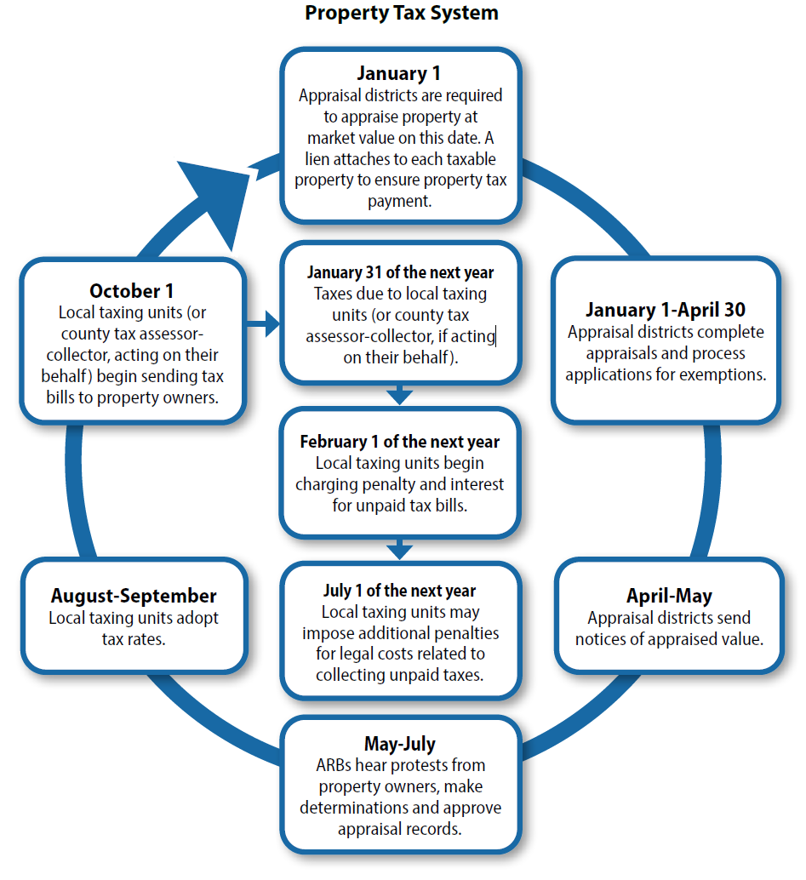
What is a Central Appraisal District?
Political subdivision of the State of Texas with a mandate to value property for all tax jurisdictions within the appraisal districts boundaries. All tax jurisdictions shall use the valuations set by the CAD for all ad valorem tax levies.
CAD valuations are delivered to Tax Offices to apply tax levies and collect revenue.
The Texas Comptroller Property Tax Assistance Division (PTAD) has oversight of the CAD.

Slide 5

Mass appraisal runs on data
High Volume: Over 800k accounts to value each year. 70k deed transactions, 50k BPP renditions, and over 300k property value protests.
Valuation Modeling: Appraisers collect data from the field annually. Property attributes are updated and used to build models for valuation (Cost Approach)
Sales Trends: Properties that have sufficient comparable sales are revalued (Sales Approach)
Income Producing Properties: Use of income and expense data can be used to determine fair market value (Income Approach)

Slide 6

More to appraisal than valuation
Institutional Stakeholder Reporting

Slide 7
Data Grain | Change in perspective
Account
Property Type
Neighborhood / Market Area
Jurisdictional
CAD Wide
Quality Control
Analyst
Appraisal Divisions
Appraiser

Slide 8
Institutional Stakeholders
Oversight Agencies
Property Tax Assistance Division (PTAD)
Appraisal Data (EARS)
Annually
Property Value Study (PVS)
Even Years
Ratio Study
Even Years
Methods and Assistance Program (MAP)
Odd Years
Taxing Jurisdictions
Certified Appraisal Roll
Annually
Supplemental Appraisal Roll
Monthly
Ad Hoc Requests
Intermittently
Municpal Bond Auditors
Audit Verification Requests
Internal
Statistical Analysis
Semi-annually
Annually
Notes:
254 counties 253 appraisal districts potter-randall

Slide 9

Smarter not Harder
Copy and paste from source materials to build tables / reports in Excel and Word
Storing data in an RDBMS and use SQL and other modern automation tools like power query and/or scripting
Use a data analysis server in a version-controlled environment with repeated reports stored as views / functions pulling from source data
Manually typing out data into a new report by hand from a printout

Slide 10

Estimated Value Report (EVR) Audit
You are a new QC data analyst.
Review the 2025 Highland Park ISD EVR and verify that the report matches the data contained in the DCAD database.
This Photo by Unknown Author is licensed under CC BY-SA

Slide 11
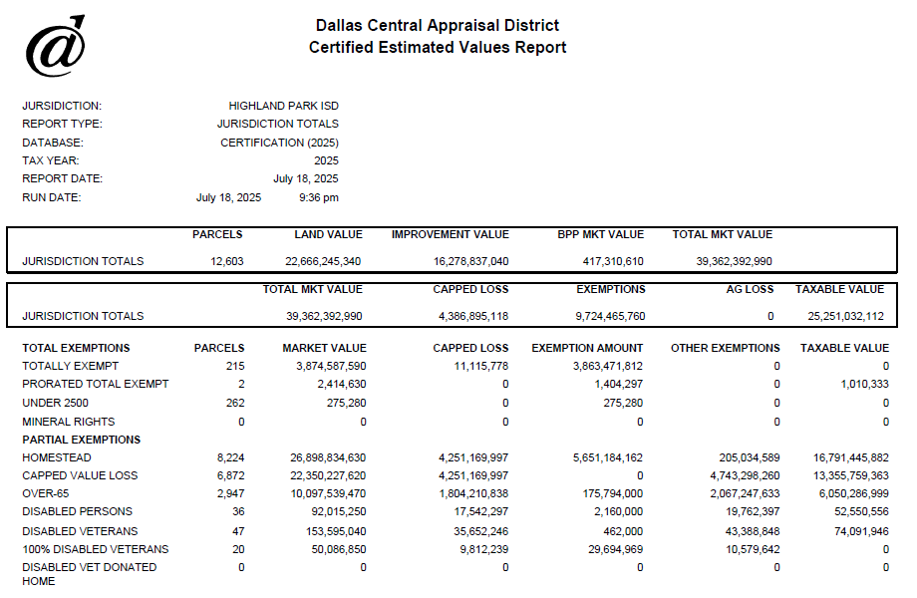
Audit Objectives
Verify the following fields on the EVR
Jurisdiction Totals Box Fields
Parcels, Land Value, Improvement Value, BPP Mkt Val, Capped Loss, Tot Mkt Val
Partial Exemptions
Homestead
Over 65
Disabled Persons
Disabled Vet
Pollution Control
Total Exemption
Sum of all Total Exemption types (they aren’t split out in the DB)

Slide 12
Audit Walkthrough
Review EVR
Jurisdiction level aggregation report
Provides Total Value, Exemptions, and Taxable Value
The upper ‘boxes’ are jurisdiction total values
Exemptions are split out by type and their amounts are listed in the ‘Exemption Amount’ column.
Review Data Dictionary (ERD)
Which group of tables do we need?
What columns contain the information we need?
Domain knowledge about how data is stored
Improvement value is the difference between market value and land value
The capped value of properties are stored, not the cap loss

Slide 13
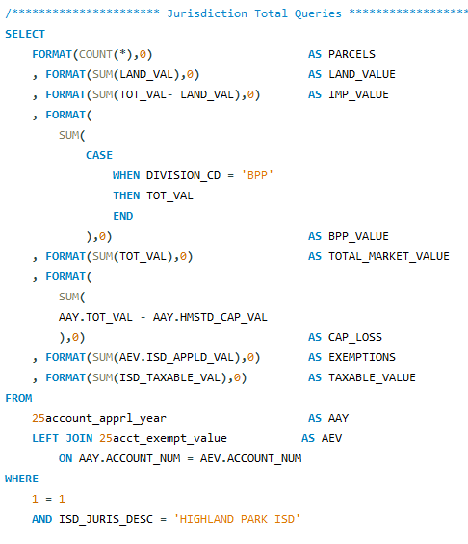
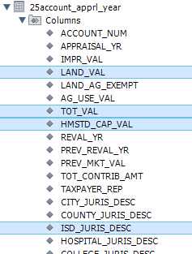
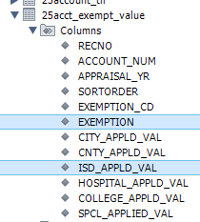
Jurisdiction totals
Table(s)
25account_apprl_yr
25account_exempt_value
Do we need to filter our data?
Use aggregation functions to find our answers
Count([field_name]) for parcel count
Sum([field_name]) for totals
How do we find Improvement Value?
How do we find BPP value?

Slide 14
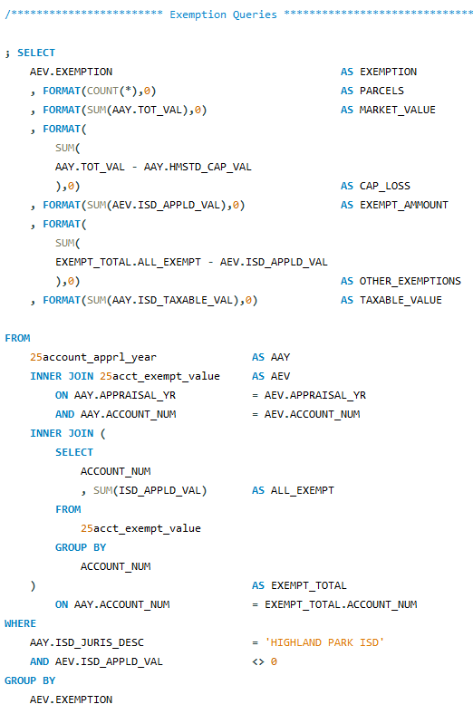
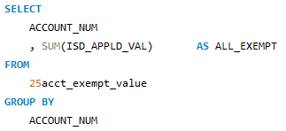
Exemptions
Tables?
25account_apprl_yr
25acct_exempt_value
Do we still need to filter our data?
How can we calculate ‘other exemptions’?

Slide 15
Review Topics
Aggregate functions
SUM(), COUNT()
CASE statements
Inner queries

Slide 16

Average Single Family Residence
Walkthrough of how to create a formatted report from a SQL query in Excel

Slide 17
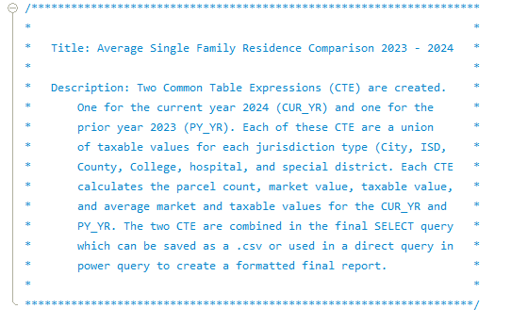
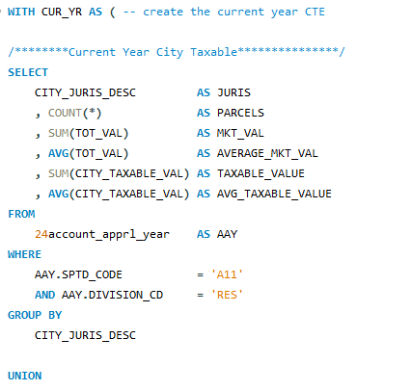
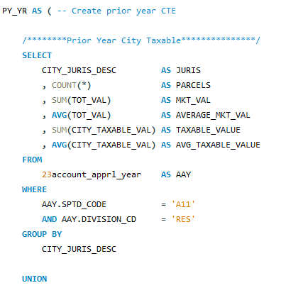
Review avg_sfr_24_23.sql
Run query and save export to avg_sfr.csv

Slide 18
Review Topics
Aggregate functions
SUM(), COUNT()
Common Table Expressions (CTE)
Excel
Power Query
Vlookup

Slide 19

Thank you
Questions, comments?
William Welles Assistant Manager | Quality Control 214.819.2392 wellesw@dcad.org

